Slide 1
EE191 Balance Beam Project Presentation

Slide 2
EE191 Balance Beam Project Presentation
Project Overview
Project Goals & Learning Objectives
Hardware Components
System Architecture Diagram
Ball Motion Theory
Air Resistance
Laplace & Transfer Function
Servo Motor Theory
Mechanical Linkage Math
Simulink Model

Slide 3
EE191 Balance Beam Project Presentation
PID Tuning
C++ Code & Sensor Testing
Sensor Problems
Troubleshooting
Motor Hardware Problems
Final Results
Group Reflection & Future Work

Slide 4
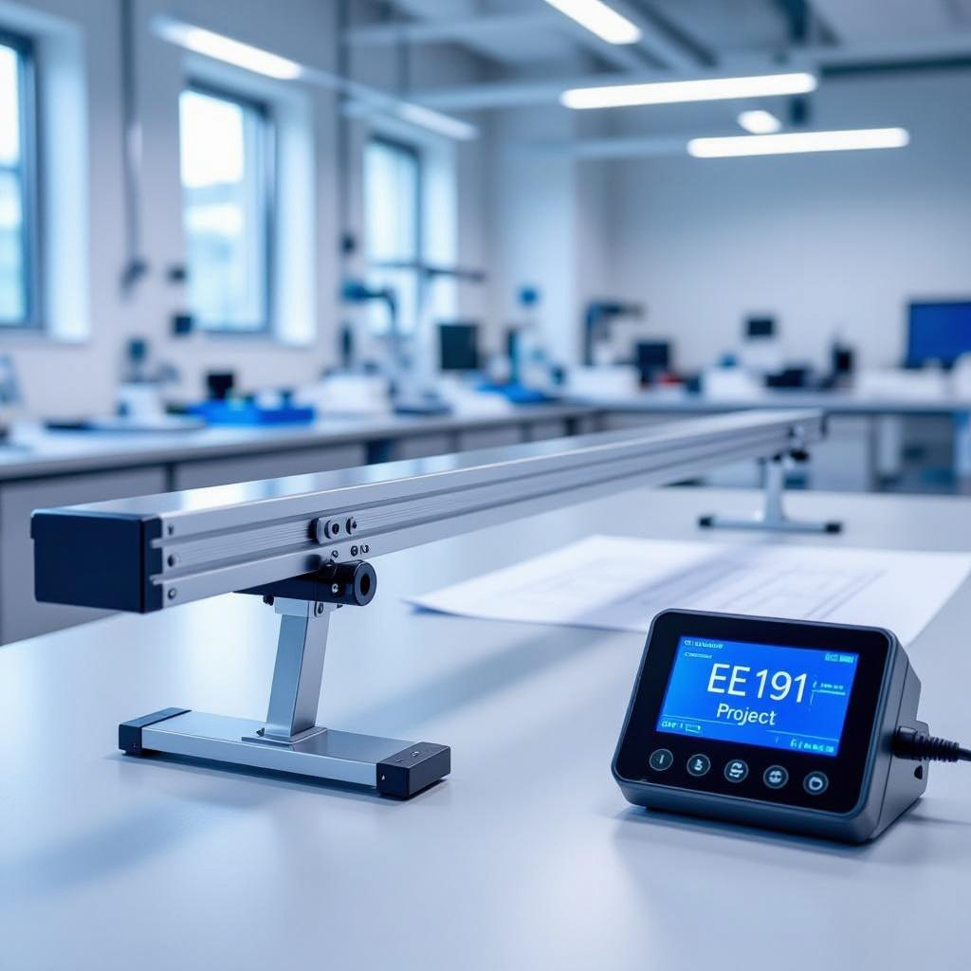
Project Overview
PID Feedback Control: PID controllers continuously adjust beam angle based on ball position, enabling dynamic stabilization through feedback.
System Components: Ultrasonic sensors detect ball position; servo motors adjust beam angle correcting ball displacement effectively.
Real-World Relevance: Balance beam control exemplifies robotics applications, highlighting control systems in automation and dynamic stabilization.
Generated on AIDOCMAKER.COM

Slide 5
Project Goals & Learning Objectives
Ball Stabilization: Achieve precise control to maintain the ball's position at center through dynamic beam adjustments.
Apply System Dynamics: Integrate theoretical system dynamics principles into practical control algorithm development and implementation.
Team Collaboration: Enhance cooperative skills by coordinating tasks, sharing knowledge and solving complex problems collectively.

Slide 6
Hardware Components
Ultrasonic Sensor: Measures ball distance by emitting sound waves and detecting echo time for precise position feedback.
Servo Motor: Adjusts beam angle via controlled rotation, translating PID commands into precise dynamic positioning.
Aluminium Beam: Rigid structural element providing stable platform and consistent response to motor-induced angular changes.

Slide 7
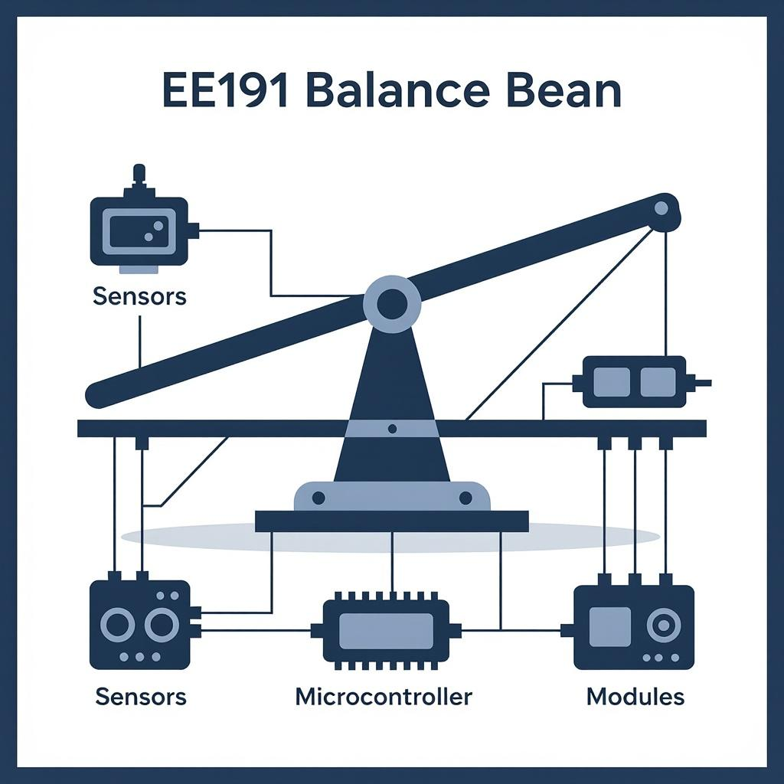
System Architecture Diagram
Sensor Measurement Input: Ultrasonic sensor continuously measures ball position, providing real-time feedback to the PID controller.
PID Controller Processing: PID block analyzes error between desired and actual ball position, generating corrective motor commands.
Motor-Driven Beam Adjustment: Servo motor actuates beam angle based on PID output, dynamically stabilizing ball position on beam.
Generated on AIDOCMAKER.COM

Slide 8
Ball Motion Theory
Rolling Ball Dynamics: A ball rolling down an incline accelerates due to gravitational force component along the slope.
Key Equation: Acceleration formula a = (3/5) g sin(θ) accounts for rotational inertia of a solid sphere rolling without slipping.
Force Components: Forces include gravity, normal force, and friction, which enable rolling motion without slipping on inclined beam.

Slide 9
Air Resistance
Terminal Velocity Measurement: Release object at rest and measure steady velocity where drag equals gravitational force precisely.
Drag Coefficient Derivation: Calculate drag coefficient from force balance equation using measured terminal velocity and object properties.
Graphical Illustration: Diagram depicts velocity-time curve stabilizing at terminal velocity, with corresponding drag force opposed to gravity.

Slide 10
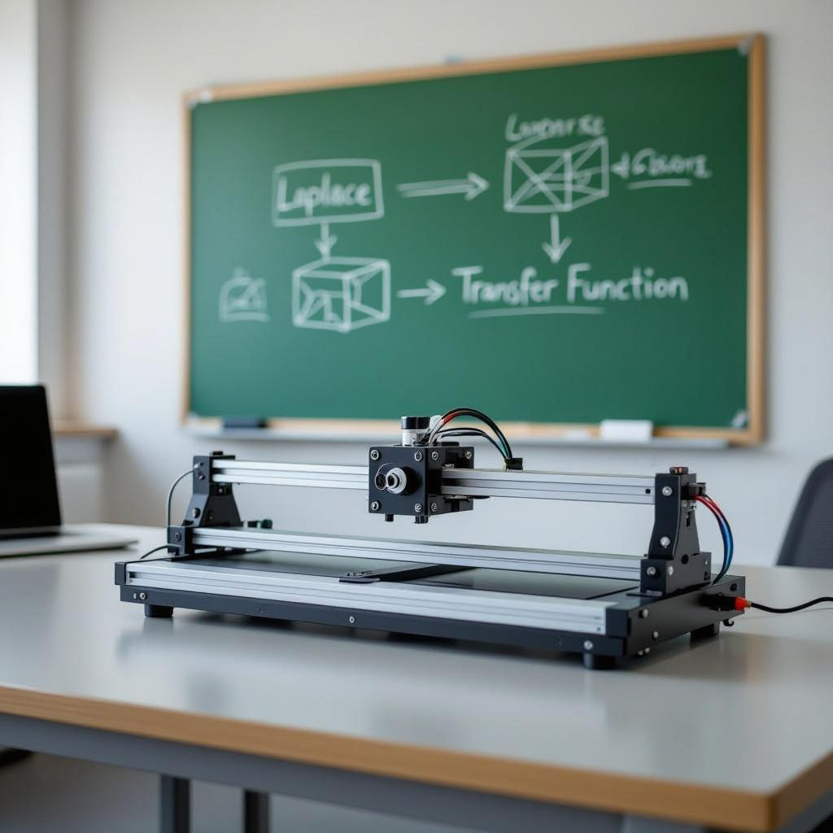
Laplace & Transfer Function
Differential Equation Transformation: Apply Laplace transform to θ̈ equation, converting time-domain dynamics into algebraic s-domain expressions.
Transfer Function Derivation: Derive H(s) = Θ(s)/Torque(s) = 3g / 5s² by isolating output-over-input ratio in Laplace domain.
Transfer Function Block Diagram: Block diagram shows input torque entering transfer function block with output beam angle Θ(s) representing system.
Generated on AIDOCMAKER.COM

Slide 11
Servo Motor Theory
Back EMF Generation: Back electromotive force emerges opposing input voltage, proportional to rotor angular velocity affecting control dynamics.
Torque Equation: Motor torque τ = K_t × I relates torque to current via motor constant for precise torque control implementation.
Control Mechanism: Pulse-width modulation adjusts input voltage, regulating current and torque to achieve desired servo motor positioning.

Slide 12
Mechanical Linkage Math
Angle Relation Equation: Linear approximation relates θ2 ≈ kθ1, derived from linkage geometry and small angle assumptions.
Linkage Geometry Details: Mechanical linkage comprises fixed pivots, rods, forming angle θ1 input and angle θ2 output linkage arms.
Diagram Description: Diagram labels θ1 and θ2 at joints highlighting pivot points and connecting rods illustrating angle transformation.

Slide 13
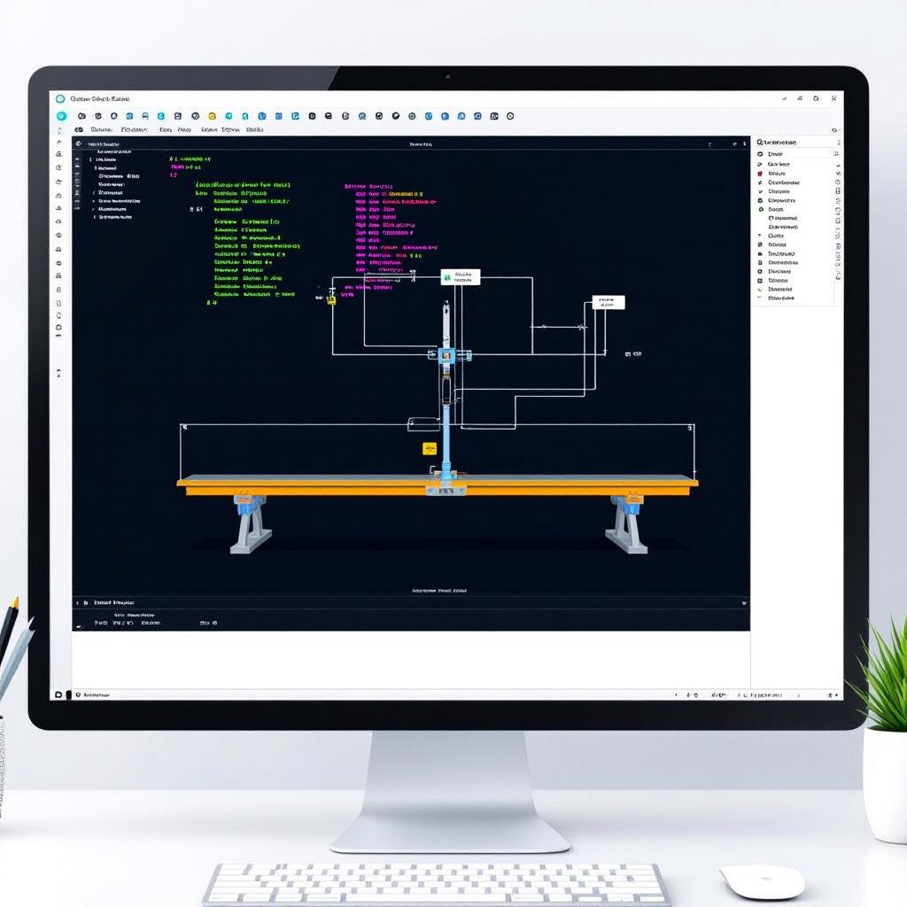
Simulink Model
Input Signal Block: Receives ball position data as input, initiating control system simulation with real-time feedback integration.
PID Controller Block: Processes error signal between desired and actual ball position, outputting proportional, integral, and derivative actions.
Closed-Loop Feedback Path: Ensures continuous correction by feeding motor-driven position changes back to the PID, stabilizing the ball on beam.
Generated on AIDOCMAKER.COM

Slide 14
PID Tuning
Tuned PID Parameters: Final PID gains optimized as P=0.43, I=0.078, D=0.58 achieving stable beam control dynamics.
Improved System Response: Tuning reduced overshoot and settling time, enhancing transient response to ball position disturbances effectively.
Scope Output Insights: Scope graph illustrates smooth setpoint tracking with minimal steady-state error and oscillation in beam angle.

Slide 15
C++ Code & Sensor Testing
Code Structure Overview: Modular C++ architecture separates sensor reading, PID control, and motor actuation for maintainability and clarity.
Sensor Testing Procedure: Conducted iterative sensor output validation using static and dynamic ball positions to calibrate distance measurements.
Pseudocode Snippet: Loop reads sensor data, computes PID output, sends PWM signals to servo motor for real-time beam adjustment.

Slide 16
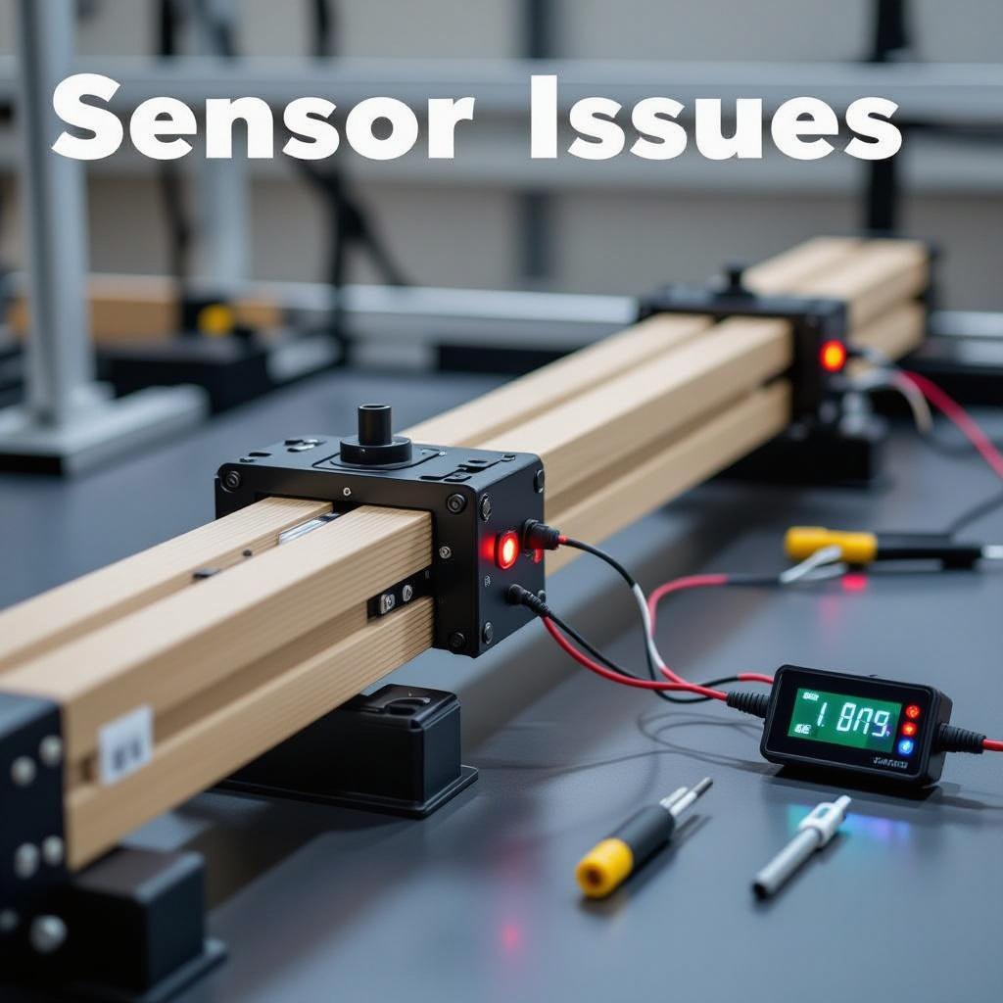
Sensor Problems
Echo Cancellation Issue: Ultrasonic sensor reads constant 40cm due to sound wave echo reflecting off metallic beam surface.
Misleading Distance Data: Persistent echo interferes with accurate ball distance measurement, causing unreliable feedback for control loop.
Impact on PID Control: False sensor readings disrupt PID calculations, leading to incorrect motor commands and unstable beam behavior.
Generated on AIDOCMAKER.COM

Slide 17
Troubleshooting
Sensor Mounting Angle Adjustments: Variations of sensor angles attempted to reduce echo effect and improve accuracy of distance readings.
Ball Size Experiments: Different ball diameters tested to evaluate influence on sensor reflection patterns and measurement reliability.
Alternative Sensor Positions: Mounting sensor at various beam locations analyzed to minimize interference and optimize echo signal quality.

Slide 18
Motor Hardware Problems
Stepper Motor Limitation: Initial stepper motor exhibited unidirectional rotation due to faulty driver circuit and control signal issues.
Servo Motor Replacement: Selected servo motor offering bidirectional rotation with integrated feedback, improving beam angle control precision.
Implementation Process: Rewired control signals, adjusted PID parameters, and calibrated servo response for seamless integration and performance.

Slide 19

Final Results
Prototype Demonstration: Photos exhibit ball stably balanced on beam, validating effective PID feedback and hardware integration.
Scope Output Analysis: Oscilloscope captures confirm system stability with smooth ball position tracking and minimal oscillatory deviation.
Visual Confirmation: Screenshots highlight real-time control response confirming rapid corrections maintaining ball at setpoint under disturbances.
Generated on AIDOCMAKER.COM

Slide 20
Group Reflection & Future Work
Team Collaboration Insights: Coordination challenges improved through iterative communication, fostering problem-solving and knowledge sharing effectively.
Sensor Accuracy Enhancements: Future work includes integrating advanced sensors with noise filtering to reduce echo interference and improve feedback reliability.
Motor & Software Refinements: Enhance motor control algorithms using adaptive tuning and optimize software for faster real-time response and stability.

